Slide 1
3D Printer
Group number 1
Presentation for English course
Collage of management academic studies
Adi Mor - Sunday | Mor Revivo - Sunday | Idan Mantin - Sunday | Linoy Elimeleh - Friday
208386938
318572716
313304503
319122610
Notes:
הצגת הנושא שבחרנו, למה בחרנו ומי המשתתפים בקבוצה

Slide 2
What is 3D printer?
Three-dimensional object from a computer-aided design model
What 3D printable models created with?
Layer by layer
Materials
Printing methods - sla / fdm
Advantages
Use today
Notes:
לדבר בהרחבה על כל נושא, קודם להציג מהי המדפסת ואיך היא עובדת
שיטוח חומרים וכו…
מה היתרונות של המדפסת ומה השימושים שלה היום - במשך 3 דקות
3D printable models may be created with a computer-aided design (CAD) package, via a 3D scanner, or by a plain digital camera and photogrammetry software

Slide 3
History
The 1980s: Birth of the main 3D Printing Techniques​
The 1990s: Emergence of the Main 3D Printers, Manufacturers, & CAD tools
The 2000s: 3D Printing Gains Media Visibility
The 2010s: Years of Visibility, Innovation and Hopes for 3D Printing
Notes:
לדבר על השנים - 1980 - המצאת הפטנט והמדפסת הראשונה
1990 - הופעת חברות גדולות של מדפסות
2000 - התחלת הדפסה אמיתית + יצירת אפליקציות וטכנולוגיות תומכות
2010 - הדפסות חדשניות והשימושים היום
3D printing is not as new as you may think! Actually, FDM (Fused Deposition Modeling) technology became quite popular and impressive for the general public around 2009 because of its media coverage. At some point, a lot of people actually thought that FDM was the only additive manufacturing technology. But FDM is not even the first 3D printing technology developed, and 3D printing actually started in the 1980s.

Slide 4
The articles
Everyday Making: Identifying Future Uses for 3D Printing in the Home
A 3D printer using column coordinate system and slice algorithm

Slide 5
Everyday Making: Identifying Future Uses for 3D Printing in the Home
Rita Shewbridge, Amy Hurst, Shaun K. Kane UMBC, Baltimore, MD 21250 {shewb1, amyhurst, skane}@umbc.edu

Slide 6
Introduction
Predicting the future daily use of 3D printing by different households.
Research:
Purpose: Examining the potential for everyday use of 3D printing in the home.
Research question: What will be the future daily use of 3D printing by average families in their homes?

Slide 7
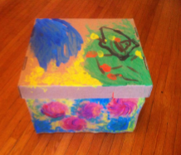
Research method
10 different households with 28 individuals, got keep a fake 3D printer in their home for 4 weeks
The individuals were asked to think about products they would be interest in creating.
The individuals got subjects and questions to help them to be more creative and think about a variety of products.

Slide 8
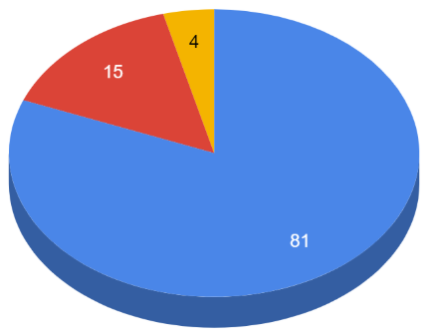
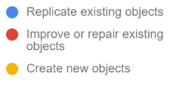
Results
Mainly uses requests:
Creating New Objects :
The individuals find it hard to describe and design their new objects
“Our results highlight improvements that are needed for design tools and 3D printing technology in order to support participants' needs for creating object” page 824
Many requests included a variety of materials or objects with moving parts which 3D printer is not supporting yet.
“While many of these objects are outside the scope of current 3D printing technology” page 823

Slide 9
Conclusions
Most of the user requests were focused on existing products (fix or duplicate).
Nowadays 3D printers can not provide the ordinary individual’s requirements.
There is a need for easier 3D design tools.
There is a need for research with real 3D printers.

Slide 10
A 3D printer using column coordinate system and slice algorithm
Chuang Jia, Liangxi Xie, Zhao Li, Wuhan University of Science and Technology {1361353784, 10830948, 157153950}@qq.com
Notes:
Hello, i am idan and i going to present the second article: “A 3D printer using column coordinate system and slice algorithm”.
This article was written in “Wuhan University of Science and Technology”.
This article explored how to print end seals with a 3D printer, in optimal way.
They explorer few types of printers, different printing methods, and slicing algorithms.

Slide 11
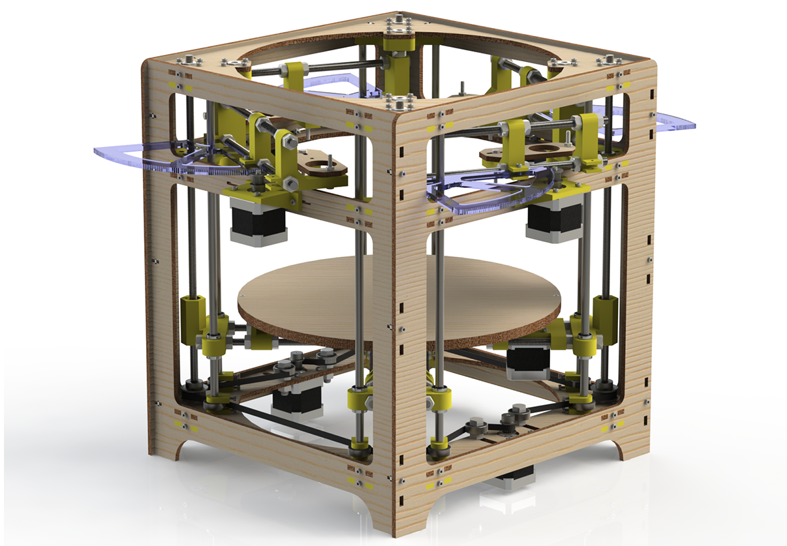
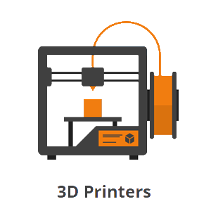

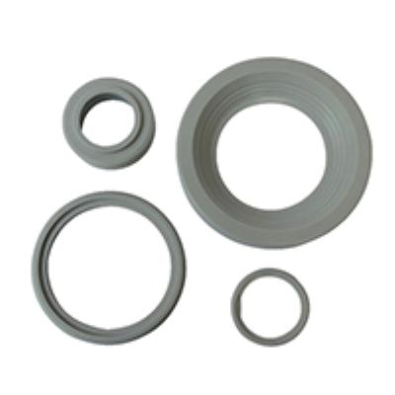
Introduction
Mass production of round end seals using a 3D printer.
Research:
Purpose: unique 3D printer and slice algorithm for printing end seals.
Research question: What is the optimal 3D printer structure and slice algorithm for creating a mass amount of end seals ?
End Seal
Notes:
This article focus on Mass production of round end seals using a 3D printer.
The Purpose of the research in this article is: find unique 3D printer and slice algorithm for printing end seals
And the research question is: What is the optimal 3D printer structure and slice algorithm for creating a mass amount of end seals ?
You can see an example of End Seal here in this slide.

Slide 12
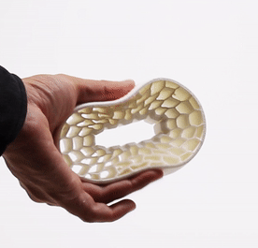
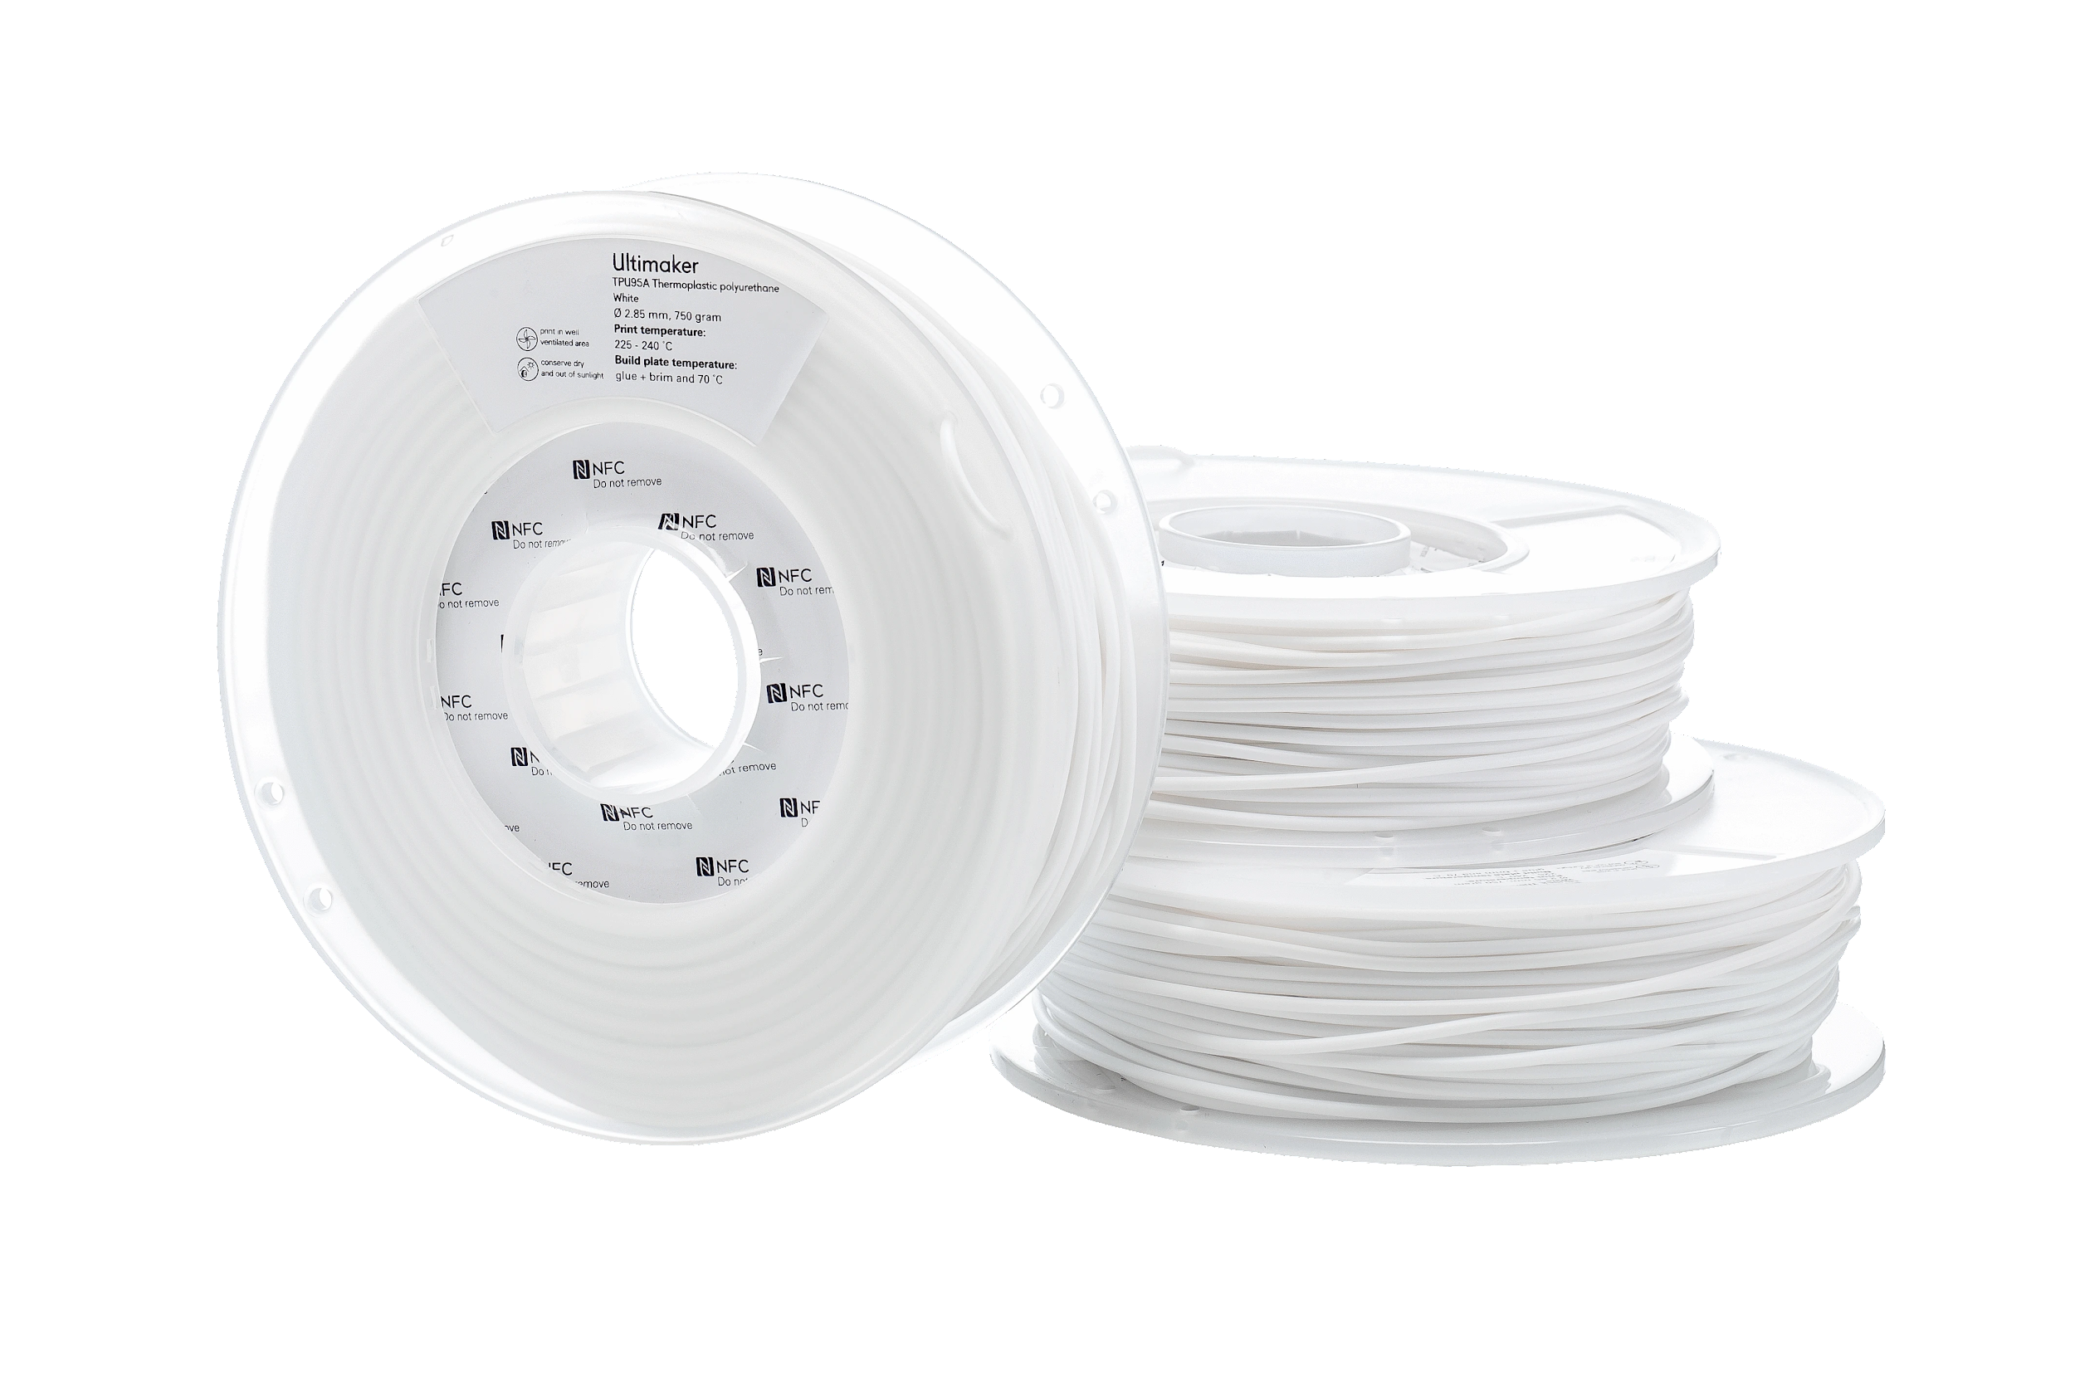

Research method
Review traditional types of 3D printers in the market
Create a 3D printer prototype that can print faster and more accurately rounded models
Compare 2 slice algorithms for accurate printing model
Printing several 3D rings seals objects with TPU material according to the chemical and physical requirements of a sealing ring
TPU
Notes:
Ok, let’s talk about the research method:
They Review traditional types of 3D printers in the market, in order to deal with rounded shapes.
While the research They Create a 3D printer prototype that can print faster and more accurately rounded models
And Compare 2 slice algorithms for accurate printing model, CATIA and CAD algorithms.
Moreover, for investaget there printing performance, They printing several 3D rings seals objects with TPU material according to the chemical and physical requirements of a sealing ring.
TPU material is flexible and contains the basic materials for sealing ring.
Down below you can see an example to TPU material.
Unlike existing 3D printers, the article added the R axis to the printer to deal with rounded shapes.
They compare 2 different algorithm in order to find the most accurate algorithm that could print ring seals fast .They Chose CATIA.
TPU material is flexible and contains the basic materials for sealing ring.
They print several 3d objects to investigate their printing performance.

Slide 13
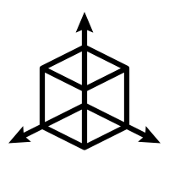

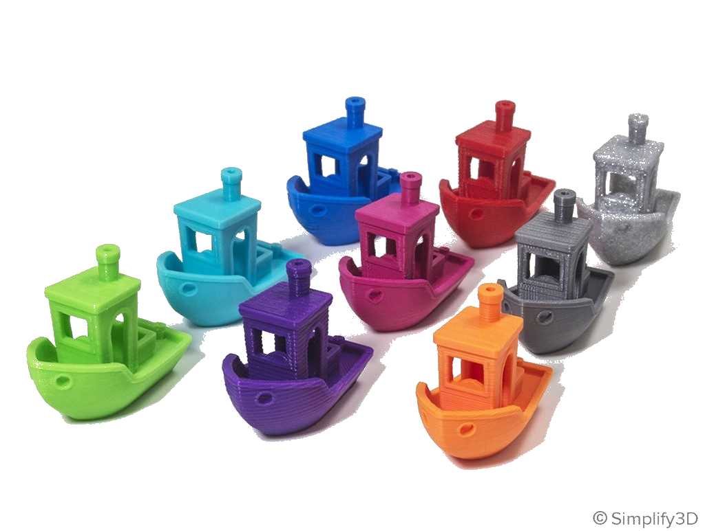
Results
Adding an R-axis to a traditional FDM printer improve accuracy of curved shapes
CATIA algorithm software is easier to use and produces a stronger solid model
The printed sealing ring is suitable for sale
Several printed objects with different design size and model size
Z
X
Y
R
Notes:
So, the result of the research is that:
Adding an R-axis to a traditional FDM printer improve accuracy of curved shapes - help to solve the complexity while printing the corv area
CATIA algorithm software is easier to use and produces a stronger solid model - CATIA software simplifies the modeling process
The printed sealing ring is suitable for sale
Several printed objects with different design size and model size
R-axis help to solve the complexity while printing the corv area
CATIA algorithm software Simplifies the modeling process, because all the process of modeling Takes place in one software. Moreover, the slicing method of CATIA makes the object stronger.
The printed sealing ring suitable the requirements of sealing ring in the industry.
While researching the printed objects, they discovered differences in object sizes due to printer calibration and differences in temperature.

Slide 14
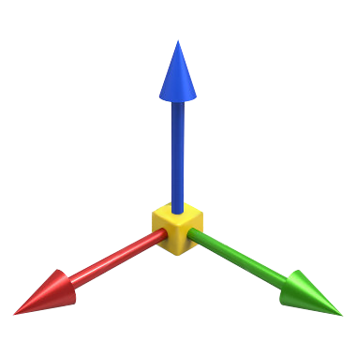



Conclusions
The column-based 3D printer is more efficient and accurate than the symmetrical axis-based 3D printer.
Use slice algorithm of CATIA saves consideration for curved 3D models.
The prototype 3D printer is less noisy and has micro-vibration.
Photoelectric switch instead of a mechanical switch gets more accurate results.
Z
X
Y
Notes:
Ok, now the conclusions of the research:

Slide 15
General Conclusions
From both articles, we concluded:
3D printers are used for industrial purposes.
The ordinary person will not be able to design new parts of his home without experience in 3D modeling.
The existing 3D printer does not meet the needs of the average household.

Slide 16

At Future
Printers will be able to print with more diverse materials.
Then there will be more household use.
There will be an increase in using industrial products.

Slide 17
Recommendation For Researchers
Doing the ‘everyday’ research with real 3D printing in the next time , so they can understand how current 3D printers may be integrated into their home environment.
Doing the ‘everyday’ research with expert users and see how they use 3D printers in and outside of the home.
Doing the ‘algorithm’ research ,but this time modify the size of the print seal for accurate printing .

Slide 18
Our summary
We very much enjoyed doing this work together.
It is a very interesting subject.
We learned a lot of things about 3D printing technology.
Experiment (watch the video).

Slide 19
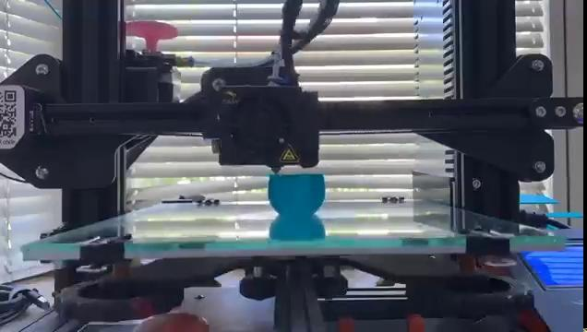
Video

Slide 20
Bibliography
Rita Shewbridge, Amy Hurst and Shaun K. Kane ,”Everyday Making: Identifying Future Uses for 3D Printing in the Home ”,Digital Fabrication Landscapes,(June 2014) :815-824
Chuang Jia ,Zhao Li and Liangxi Xie , “A 3D printer using column coordinate system and slice algorithm” , Wuhan University of Science and Technology (May 2018): 95-99

Slide 21
Questions ?

